Slide 1
Driveline Open Biomechanics Project
Trey Chase

Slide 2
Agenda
Introduction/Goals
Importance
The Data
Research Objectives
Assumptions
Model Selection
Model Performance
Five Important Movements
Takeaways

Slide 3

Introduction/Goals
Analyze pitching data provided by Driveline to find a quantitative link between mechanics and velocity
All pitches are fastballs in this study
Data is pre-cleaned by Driveline
Pitchers vary in level from high school to MLB (most are college)
Draw conclusions to streamline mechanical adjustments

Slide 4
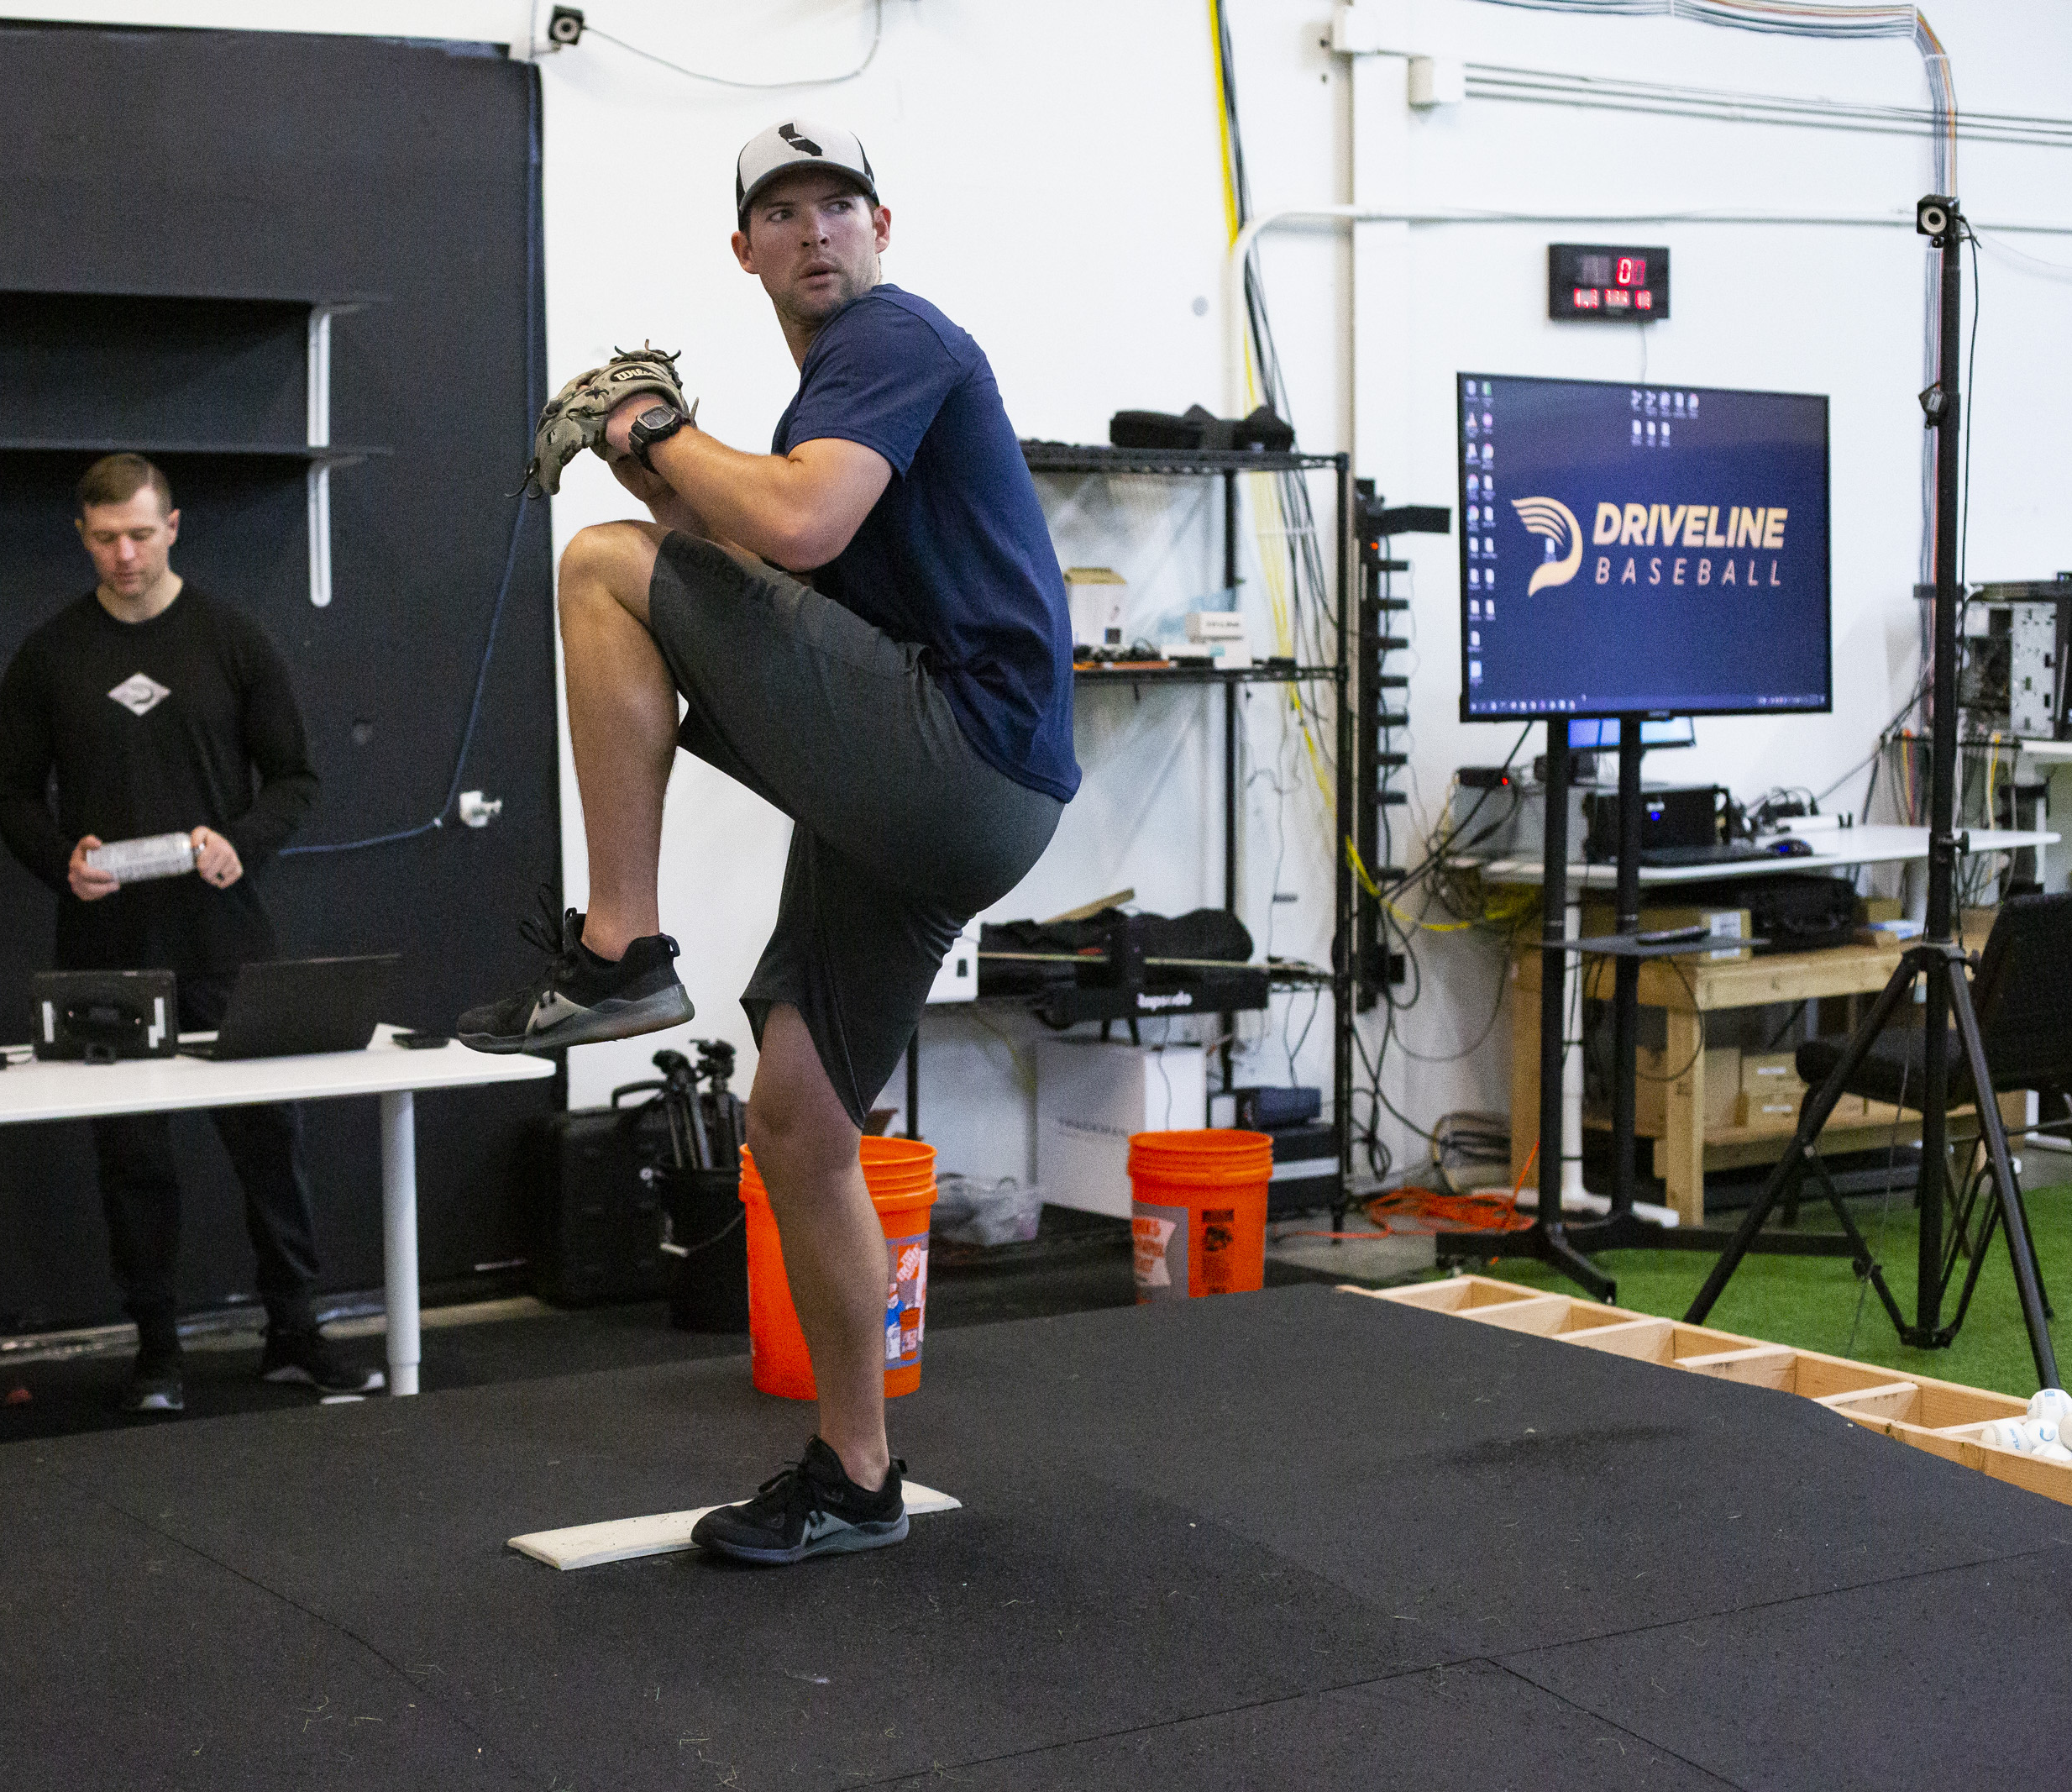
Why is this important?
Velocity is highly correlated with K-rate
Highly desired by scouts
Streamlined mechanics mitigate injuries
35% of all pitchers have had Tommy John surgery in their career
Increase efficiency of training programs
Contribute to players’ athletic development

Slide 5
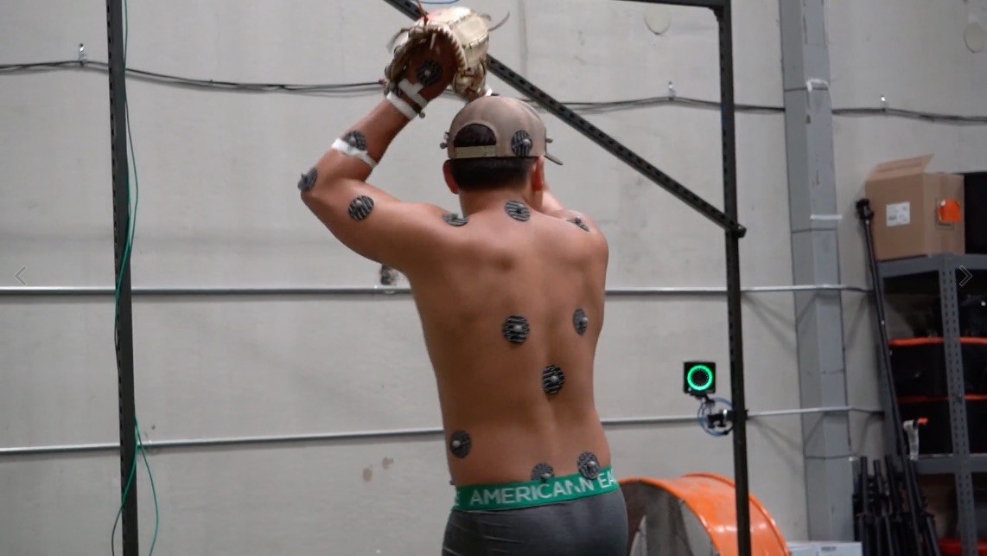
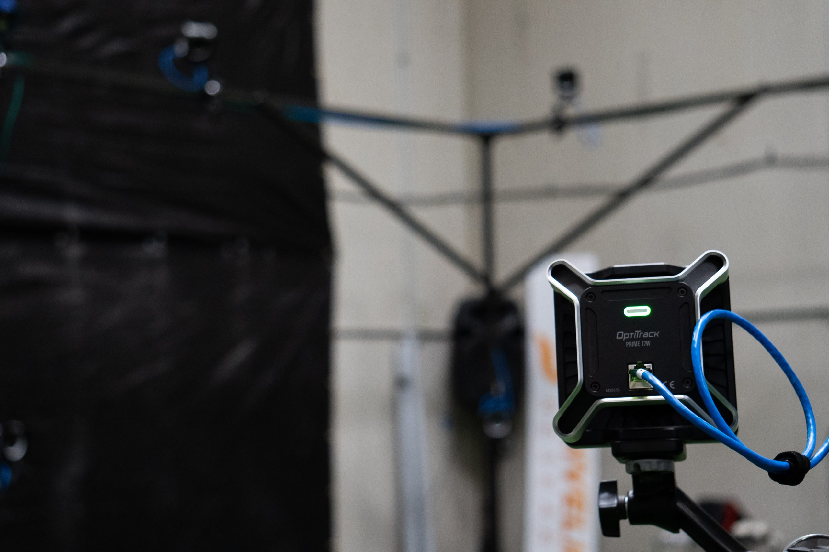
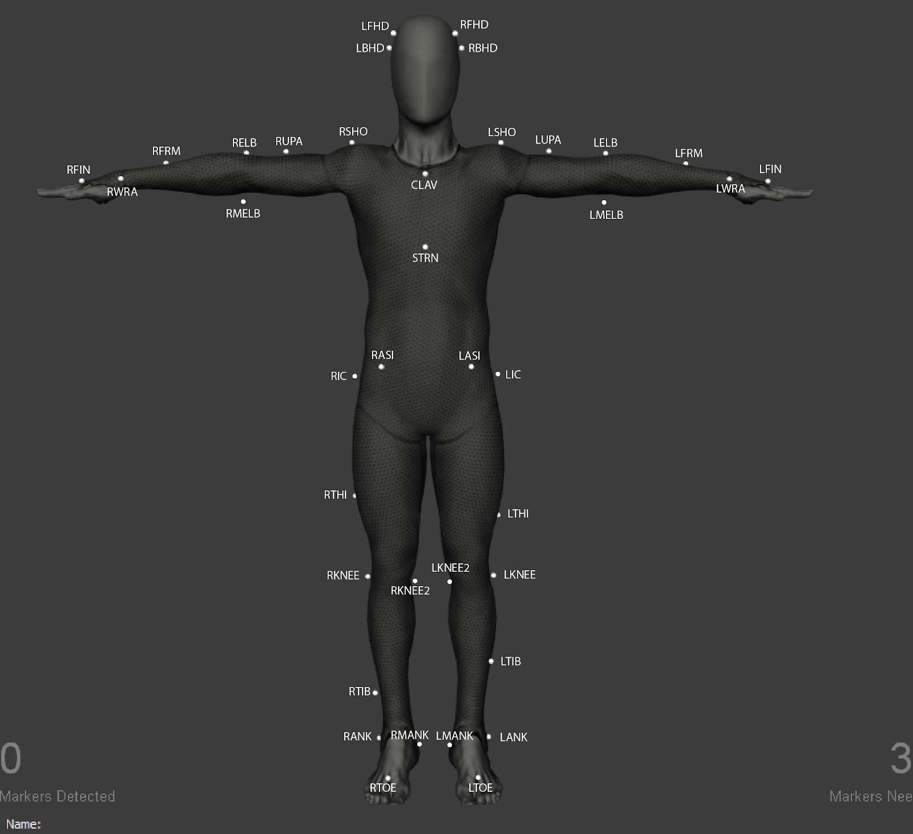
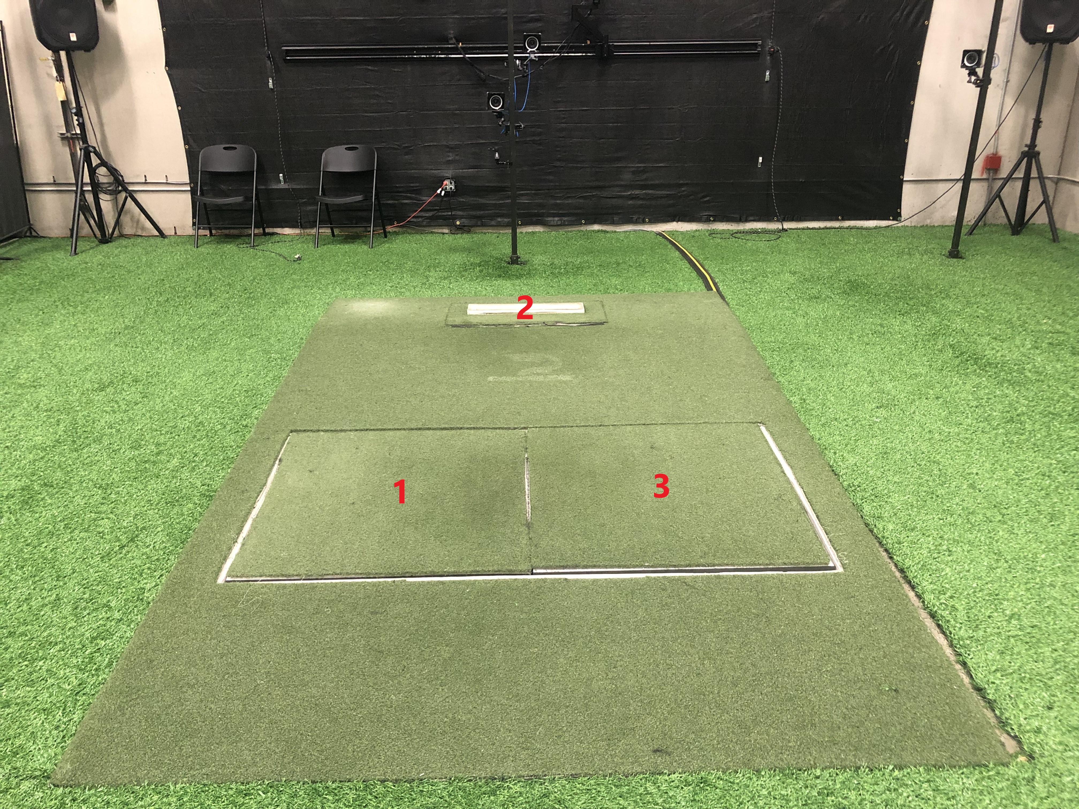
Obtaining the Data
Force Plates
Radar Guns
Motion Capture
High-tech cameras

Slide 6
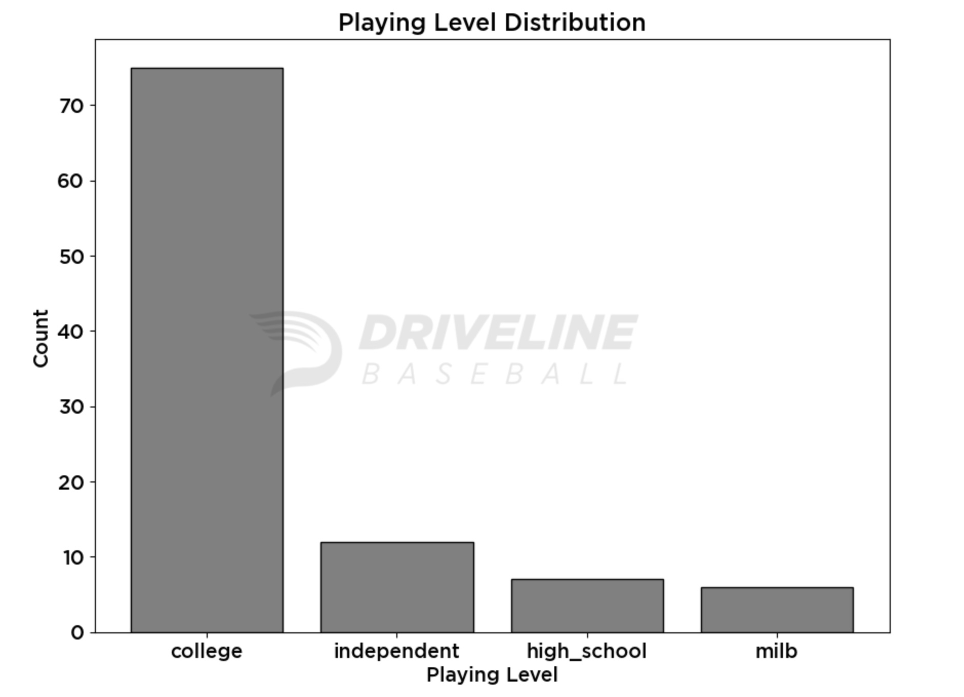
The Observations

Slide 7
Research Objectives
Predict fastball velocity from the mechanical metrics provided
Split data into train and test splits
Step-wise regression algorithm
Determine the five most significant movements linked with velocity
Draw the terms in the model with the most statistically significant coefficients

Slide 8
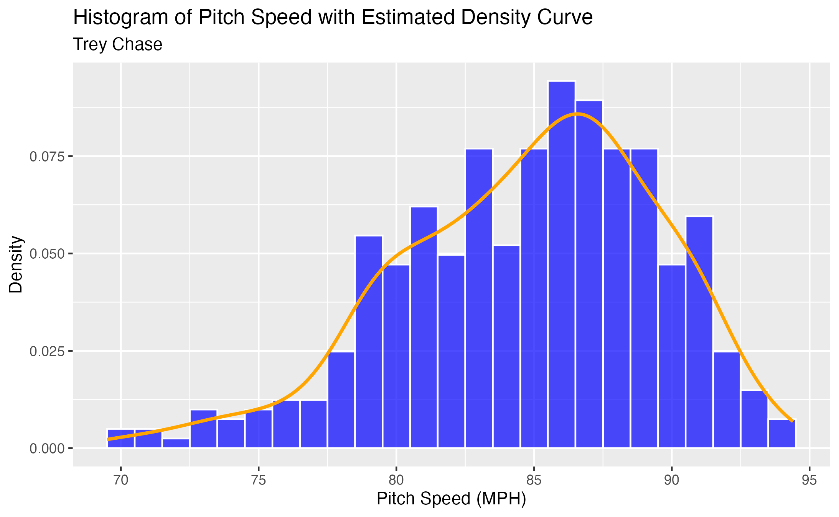
Pitch Speed Distribution
Distribution is slightly skewed left
Approximately normal

Slide 9
Assumptions
Multicollinearity
The explanatory variables cannot be highly correlated with one another
Use Variance Inflation Factor (VIF)
Heteroscedasticity
The variance of errors is roughly constant
Residuals should be normally distributed

Slide 10
Model Selection
Linear Regression
Step-wise algorithm
At each step, multiple models are created by dropping a variable
Models are compared
One with the lowest prediction error moves to the next step
Pitch Speed = β0 + β1 * Variable_1 + β2 * Variable_2 + βn * Variable_n + ε

Slide 11
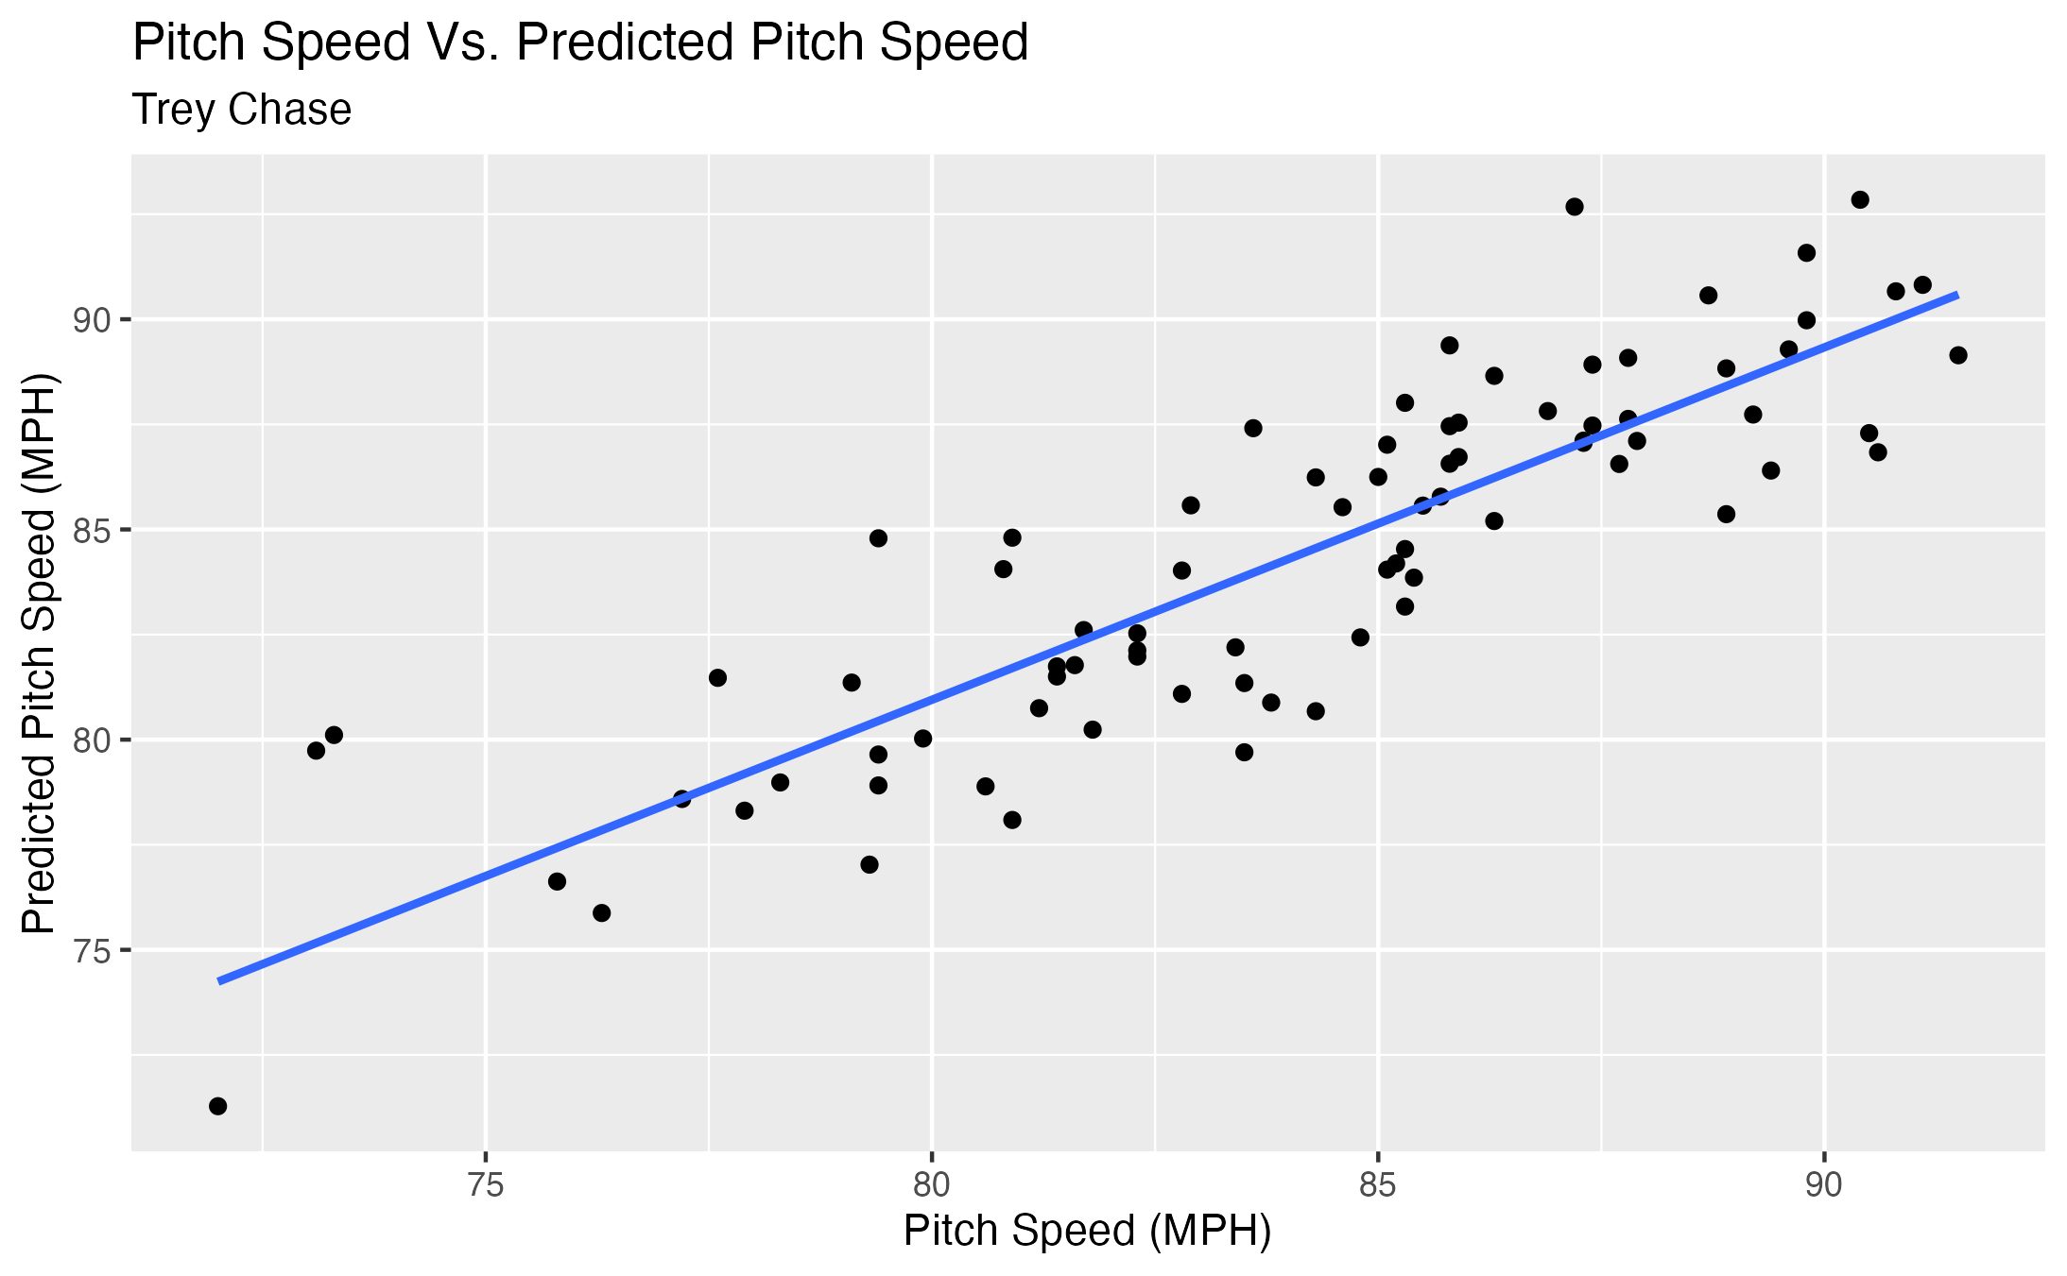
Model Performance
Achieves an R-squared value of 0.82
Bootstrap 95% confidence interval of roughly (0.80, 0.87)

Slide 12
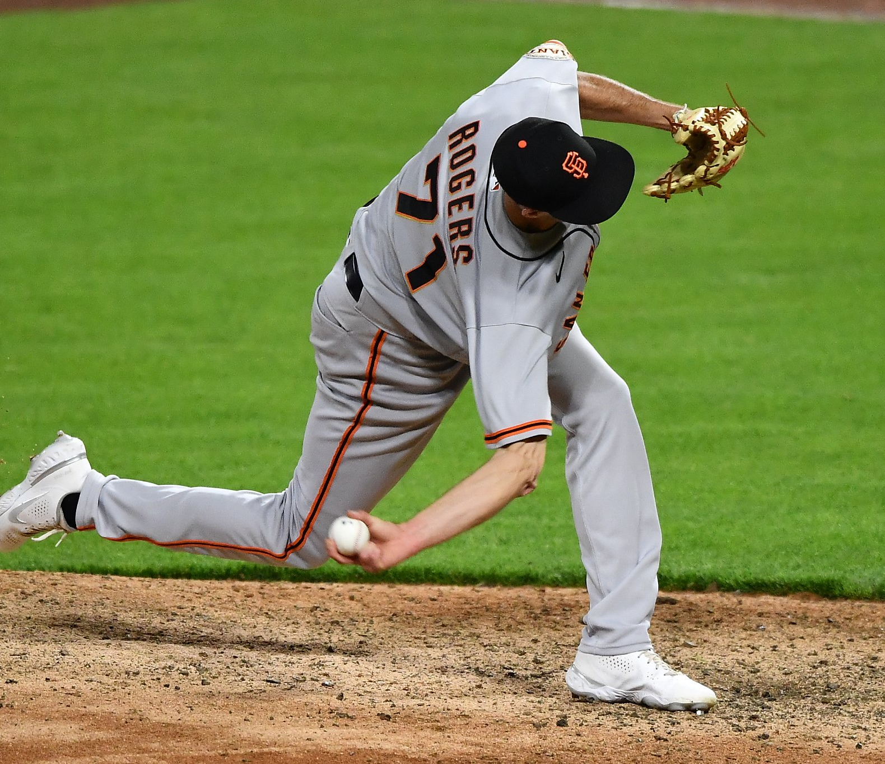
Limitations
Dataset contains 411 observations
Extremely dense data
Outliers
Just fastballs
Pitcher to pitcher variance

Slide 13
Five Important Movements
Took five terms with the most statistically significant coefficients
Most prominent in determining fastball velocity
Elbow Transfer Force (Joules)
Maximum Torso Rotational Velocity (degrees/second)
Pelvis Rotation Force (degrees)
Torso Rotation (degrees)
Maximum Center of Gravity Velocity (Meters/Second)

Slide 14
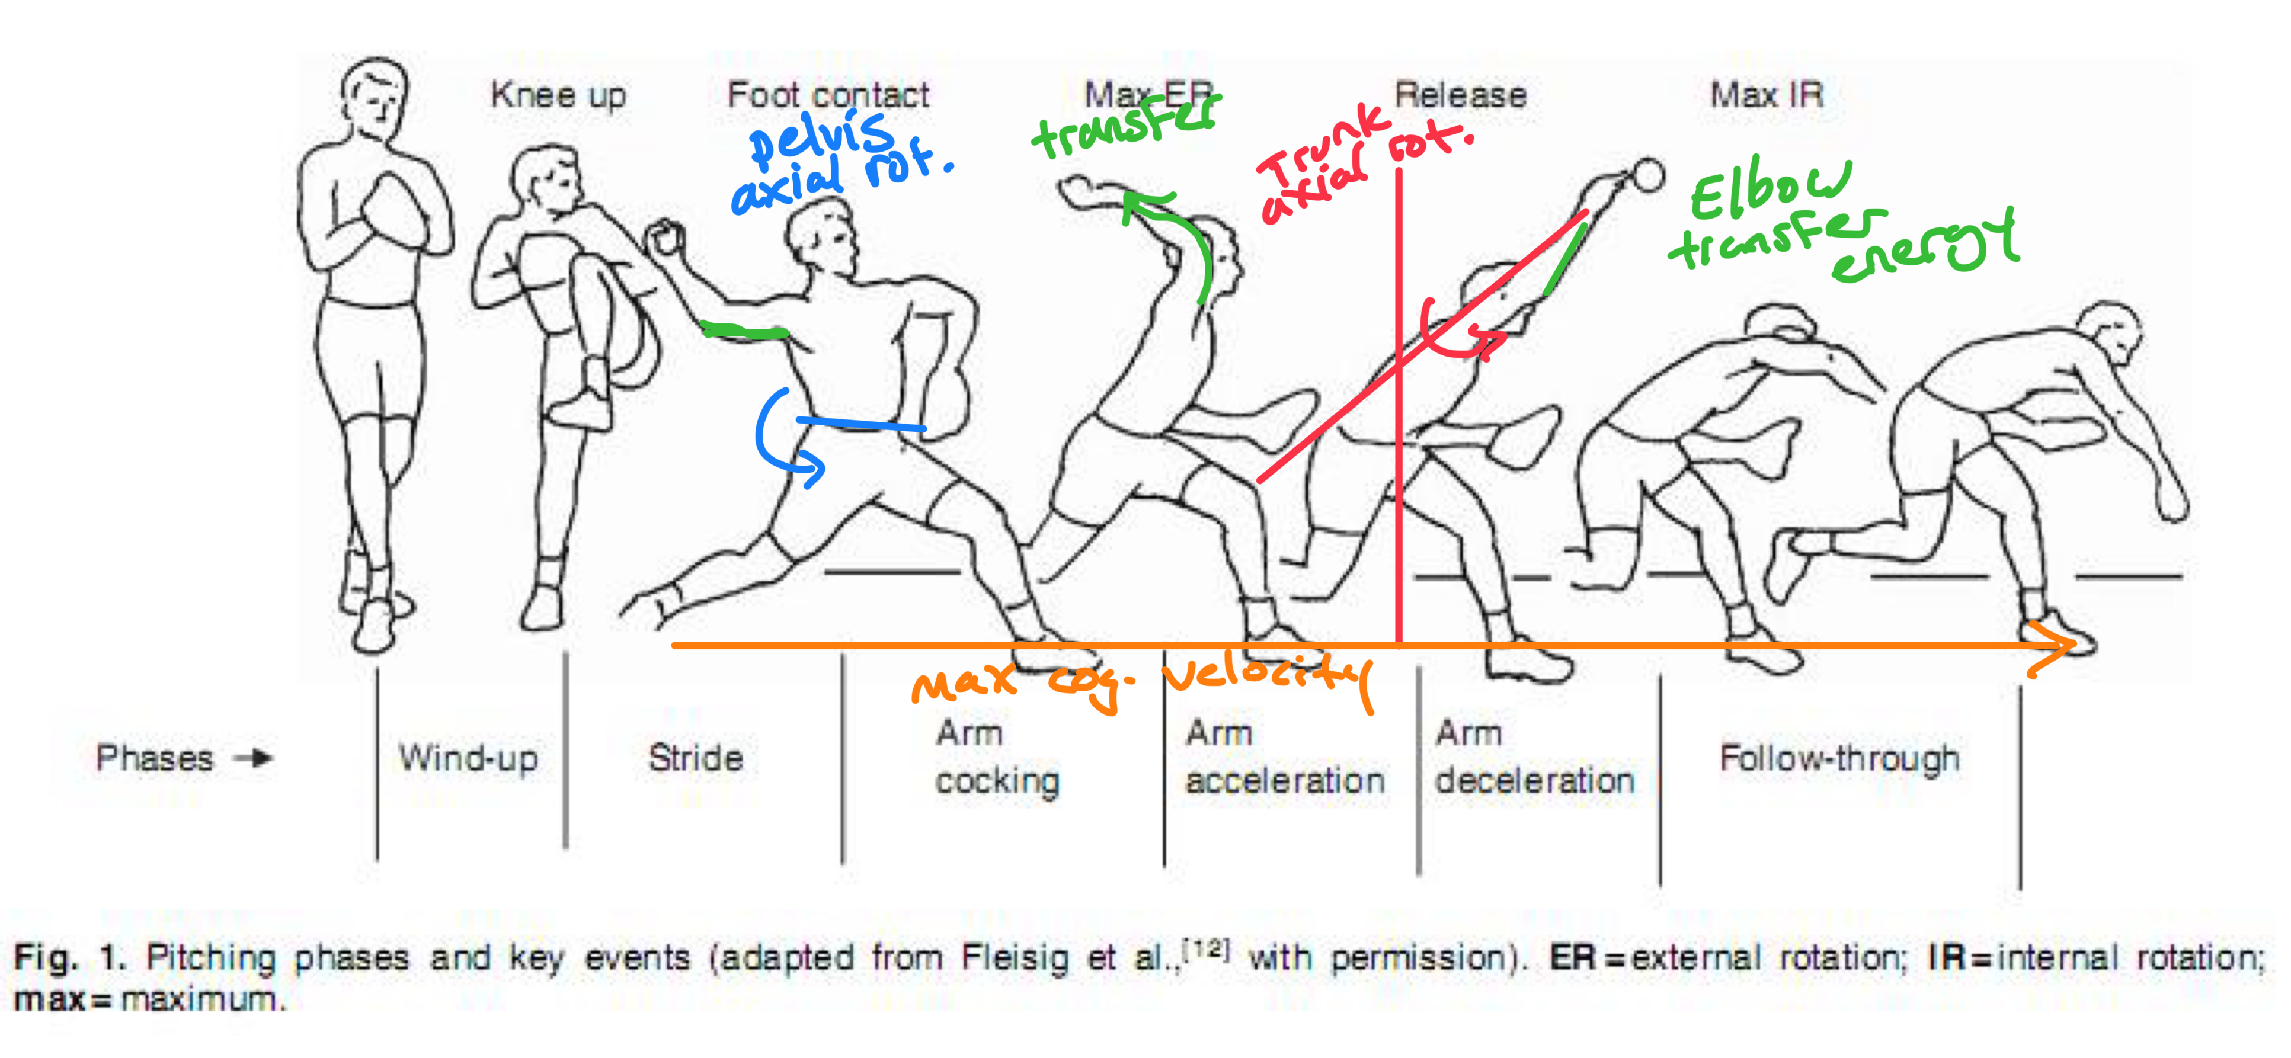
Movements Visualized

Slide 15
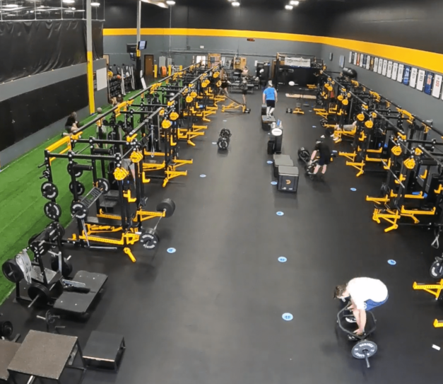
Takeaways
Linear regression model is a viable choice for predicting fastball velocity
Bootstrapping is an efficient method to check the validity of statistics
Learned which movements determine velocity
Pelvis rotation
Torso rotation
Quickness of movement towards home plate
Transfer of energy in the elbow
Trainers: emphasize explosive rotational exercises

Slide 16
Thank you!

